Slide 1
On the Design of a Fault-Tolerant Scalable 3D NoC-Based Digital Neuromorphic System With On-Chip Learning
Research Paper Reading
RPR
By: O. M. Ikechukwu, K. N. Dang, and A. B. Abdallah, “On the Design of a Fault-Tolerant Scalable Three Dimensional NoC-Based Digital Neuromorphic System With On-Chip Learning,” IEEE Access, vol. 9, pp. 64331–64345, Jan. 2021, doi: 10.1109/access.2021.3071089.
Presenter: Yassine Khedher
m5281019

Slide 2
Overview
Introduction
Prior Works
NASH System Architecture
Evaluation Results
Conclusion

Slide 3
Overview
Introduction
Prior Works
NASH System Architecture
Evaluation Results
Conclusion

Slide 4
Introduction
Context of the Work:
Increasing demand for scalable and efficient neuromorphic systems
Limitations in existing 2D NoC architectures
Motivation of the Work:
Need for fault-tolerant and high-throughput neuromorphic systems
Enhancing parallelism and reducing communication costs
Contribution of the Work:
Development of a 3D NoC-based neuromorphic system (NASH)
Implementation of fault-tolerant routing algorithms
Improved performance and fault tolerance in SNNs
Notes:
• This work addressed the growing need for scalable and efficient neuromorphic systems, overcoming the limitations of existing 2D NoC architectures.
• The motivation is to create fault-tolerant systems with enhanced parallelism and reduced communication costs.
• The key contributions include the development of the NASH system, implementation of advanced fault-tolerant routing algorithms, and significant improvements in performance and fault tolerance for spiking neural networks.

Slide 5
Overview
Introduction
Prior Works
NASH System Architecture
Evaluation Results
Conclusion

Slide 6
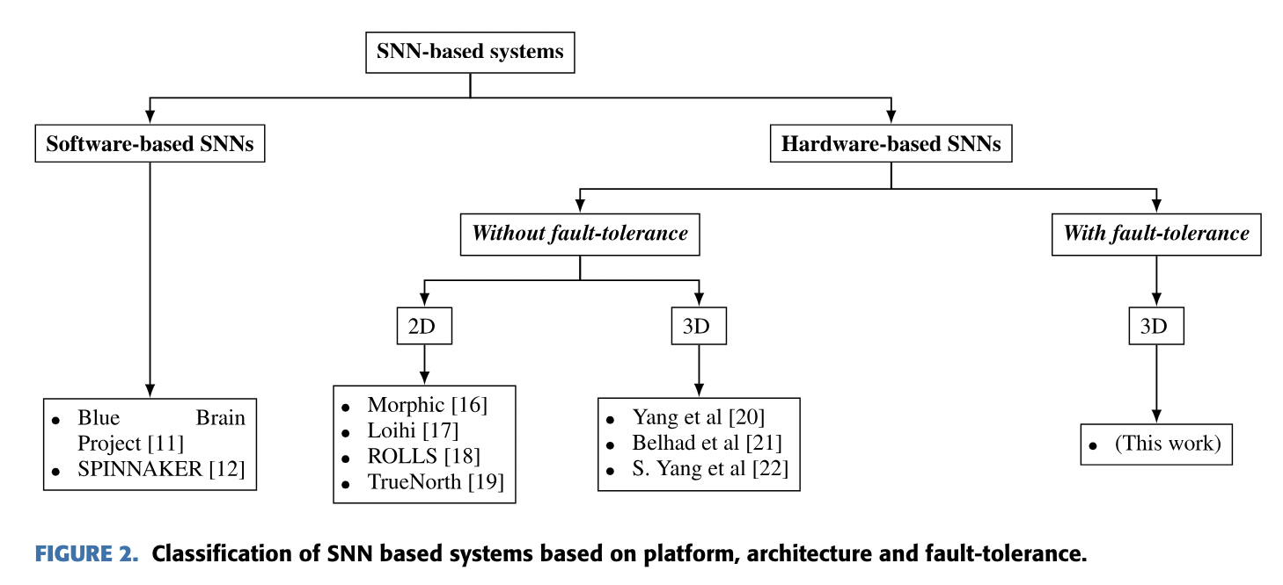
Prior Works
Existing neuromorphic systems:
Notes:
Previous works in neuromorphic processors span a range of applications, from brain simulation to automotive sensors. Notable 2D implementations include Loihi, TrueNorth, and ROLLS, each with unique features and limitations. Advancements in 3D neuromorphic systems, such as stacked accelerators and large-scale SNN simulations, highlight the potential for improved scalability and performance. The use of TSVs in 3D-NoC architectures further mimics biological neural networks, addressing challenges in connectivity and fault tolerance.

Slide 7
Overview
Introduction
Prior Works
NASH System Architecture
Evaluation Results
Conclusion

Slide 8
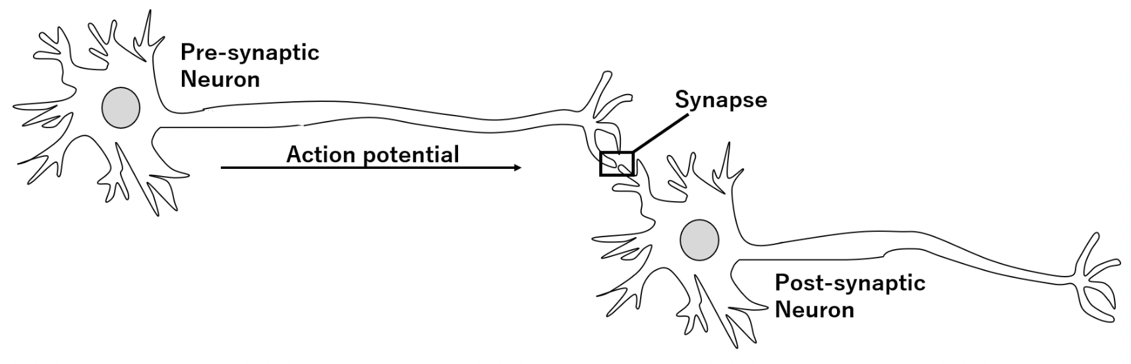
NASH System Architecture Overview
Spiking Neural Networks (SNNs):
Biological Inspiration:
Mimic the behavior of biological neurons
Neurons communicate via discrete spikes
Neuron Models:
Leaky Integrate-and-Fire (LIF) neurons
Learning Mechanisms:
Spike-Timing-Dependent Plasticity (STDP)
Advantages:
Efficient temporal information processing
Energy efficiency and sparsity
FIGURE. Two neurons communicating via a synapse.
Notes:
Spiking Neural Networks (SNNs) are inspired by the brain's neural networks, using discrete spikes for communication.
The Leaky Integrate-and-Fire (LIF) neuron model and Spike-Timing-Dependent Plasticity (STDP) are key components.
SNNs offer efficient temporal processing and energy efficiency, making them suitable for neuromorphic systems.

Slide 9
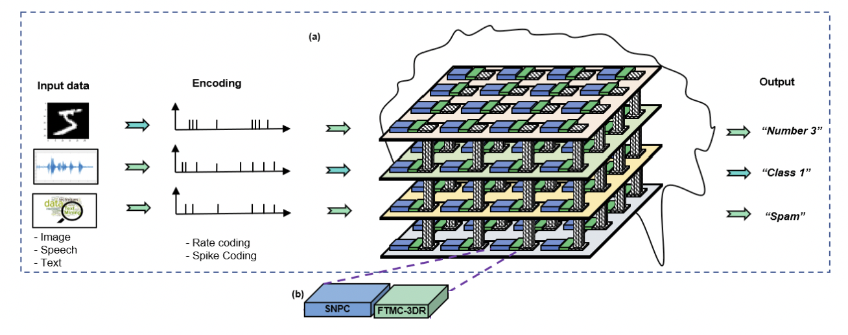
NASH System Architecture Overview
NASH system architecture:
FIGURE 3. High level view of NASH System Architecture: (a) NASH system architecture illustrated in a 4 × 4 × 4 configuration.
(b) A single node in NASH system comprising of an SNPC and a FTMC-3DR.
Notes:
The NASH system is built with spiking neuron processing cores and a fault-tolerant 3D router, designed to enhance scalability and reliability.
With key components such as SNPCs, FTMC-3DR

Slide 10
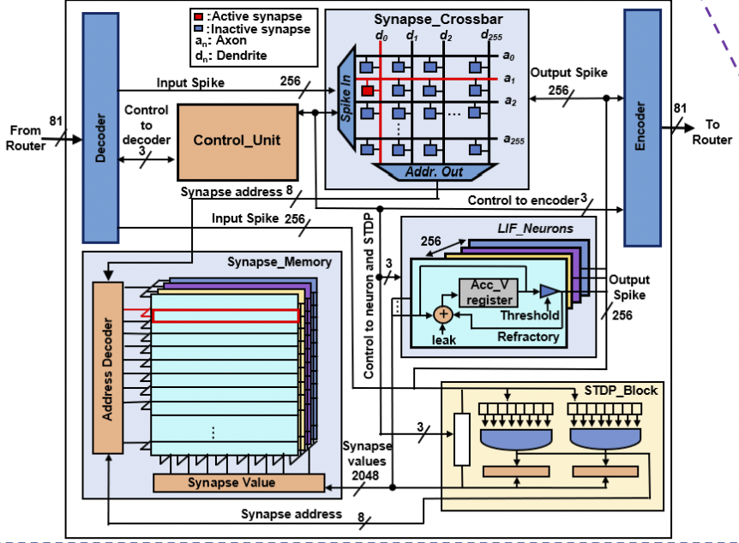
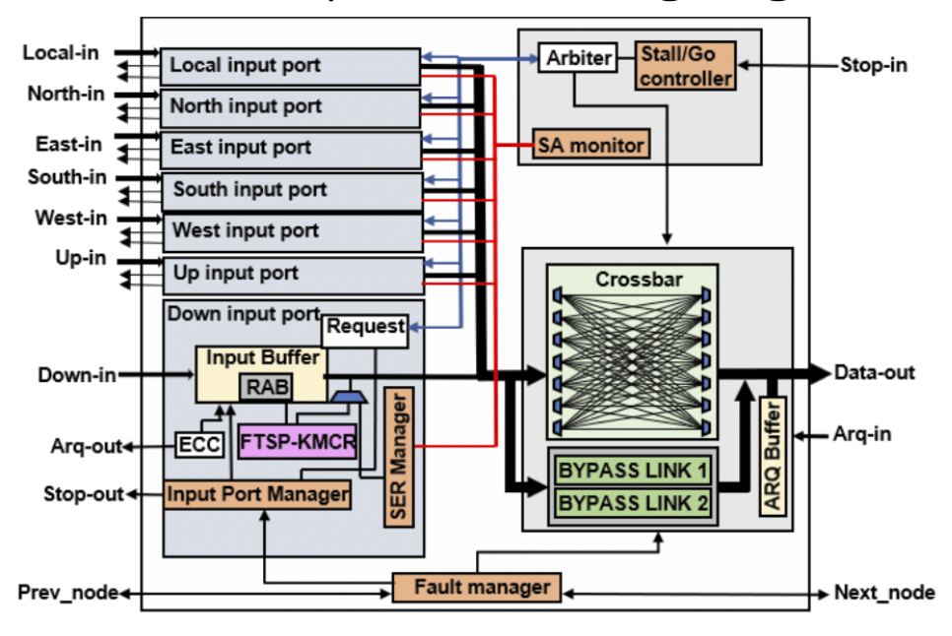
NASH System Architecture Details
FIGURE 3 (c): An architecture of the SNPC comprising of the synapse memory, synapse crossbar, LIF neurons, control unit, encoder/decoder, and an STDP learning block
FIGURE 3(d): Architecture of the FTMC-3DR comprising of the input ports, crossbar, switch allocator, arbiter and flow control.
Notes:
Explanation of Spiking Neuron Processing Cores (SNPCs)
Explanation of Fault-tolerant multicast 3D router architecture (FTMC-3DR)
Utilization of LIF neurons and STDP for learning

Slide 11
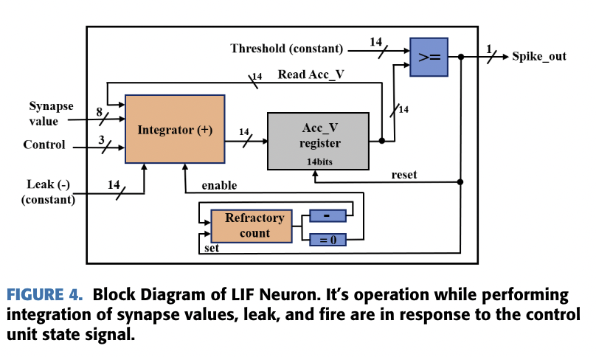
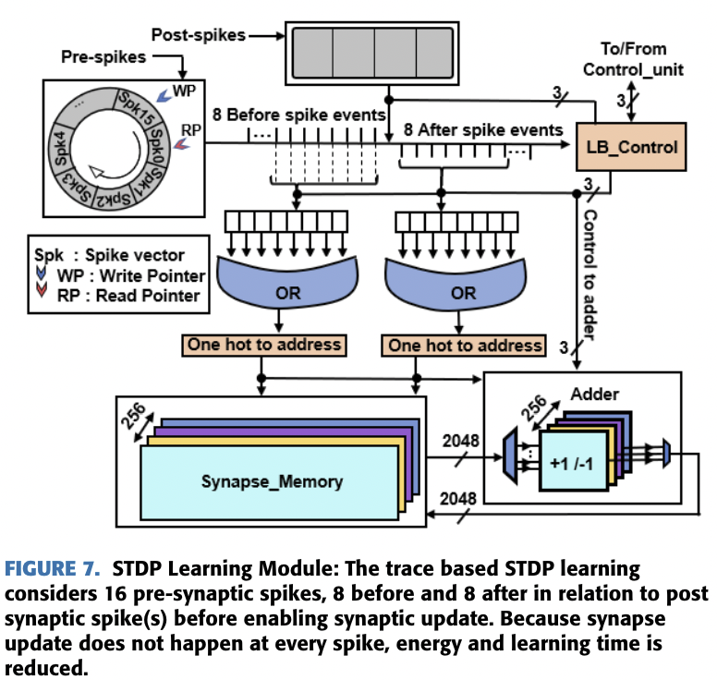
NASH System Architecture Details
• Leaky Integrate and Fire (LIF) block
• Spike-Timing-Dependent-Plasticity (STDP) learning module
Notes:
Explanation of Leaky Integrate and Fire (LIF) block
Explanation of Spike-Timing-Dependent-Plasticity (STDP) learning module

Slide 12
NASH System Architecture
Main Points of NASH System
Scalability and Parallelism:
3D NoC architecture for high scalability
Parallel update of neurons
Fault Tolerance:
Advanced routing algorithms (FTSP-KMCR, FT-KMCR)
Maintains high accuracy under faults
Performance:
High throughput and low communication cost
Efficient on-chip learning
Notes:
The NASH system uses a 3D NoC architecture for scalability and parallelism, enabling the parallel update of neurons.
Its advanced routing algorithms provide fault tolerance, maintaining high accuracy even under faults.
NASH achieves high throughput and low communication costs, with efficient on-chip learning capabilities.

Slide 13
Overview
Introduction
Prior Works
NASH System Architecture
Evaluation Results
Conclusion

Slide 14
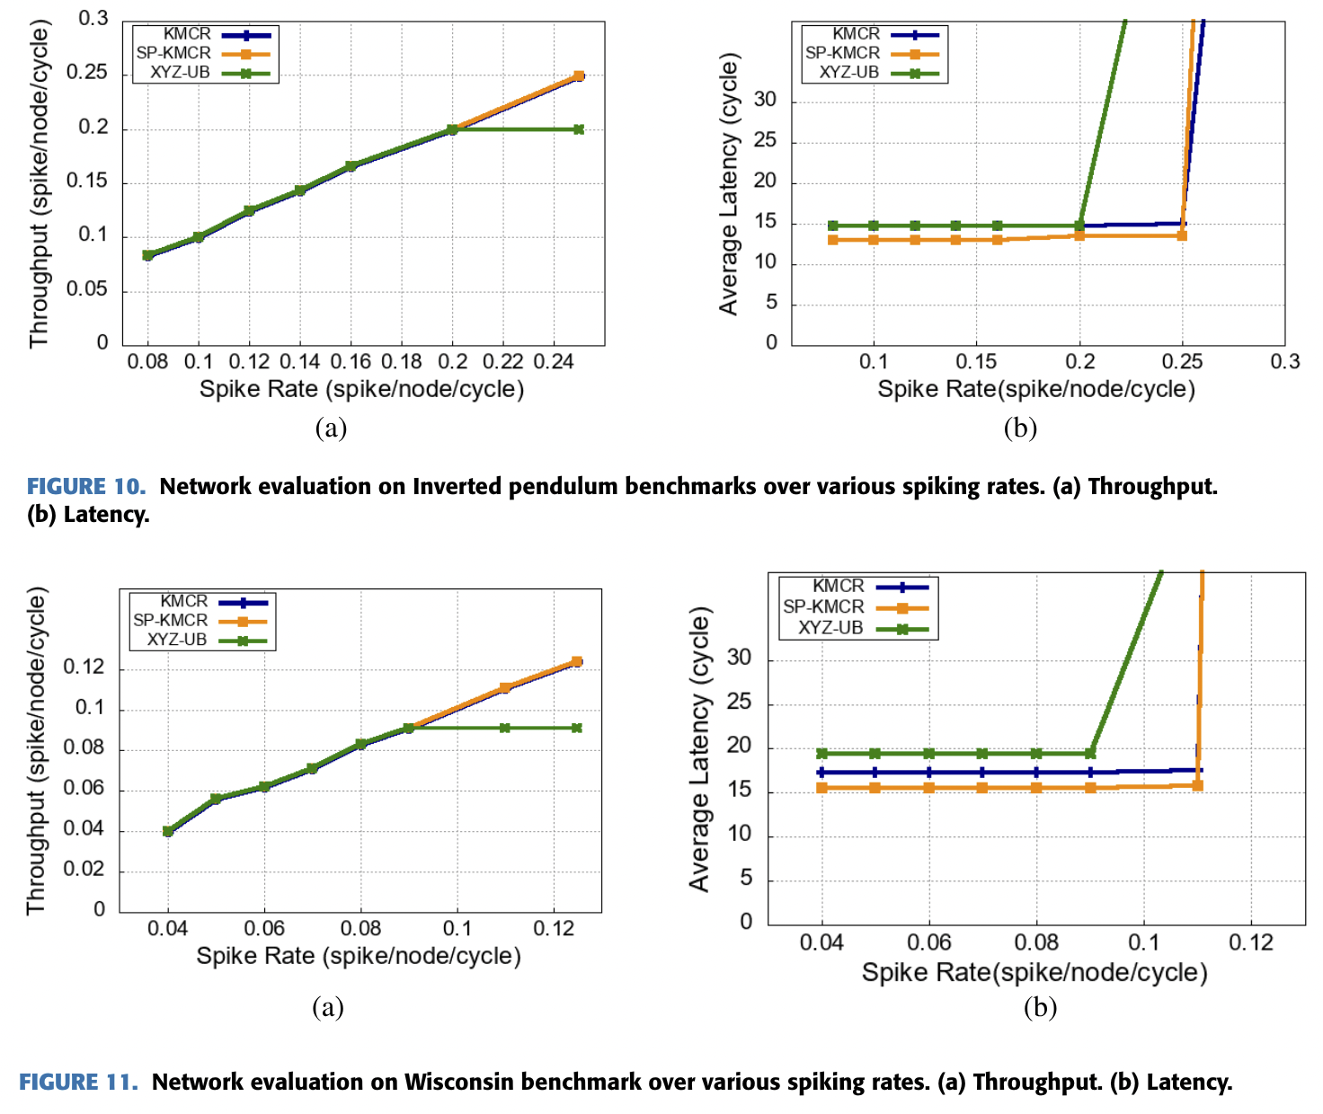
Evaluation (without faults)
Benchmarks:
- Inverted Pendulum
- Wisconsin
Notes:
Two benchmarks, Inverted Pendulum and Wisconsin, were used to evaluate neuron interconnect performance.
• The first experiment was carried out without faults, using the SP-KMCR, KMCR, and the baseline XYZ unicast based (UB) multicast routing algorithms.

Slide 15
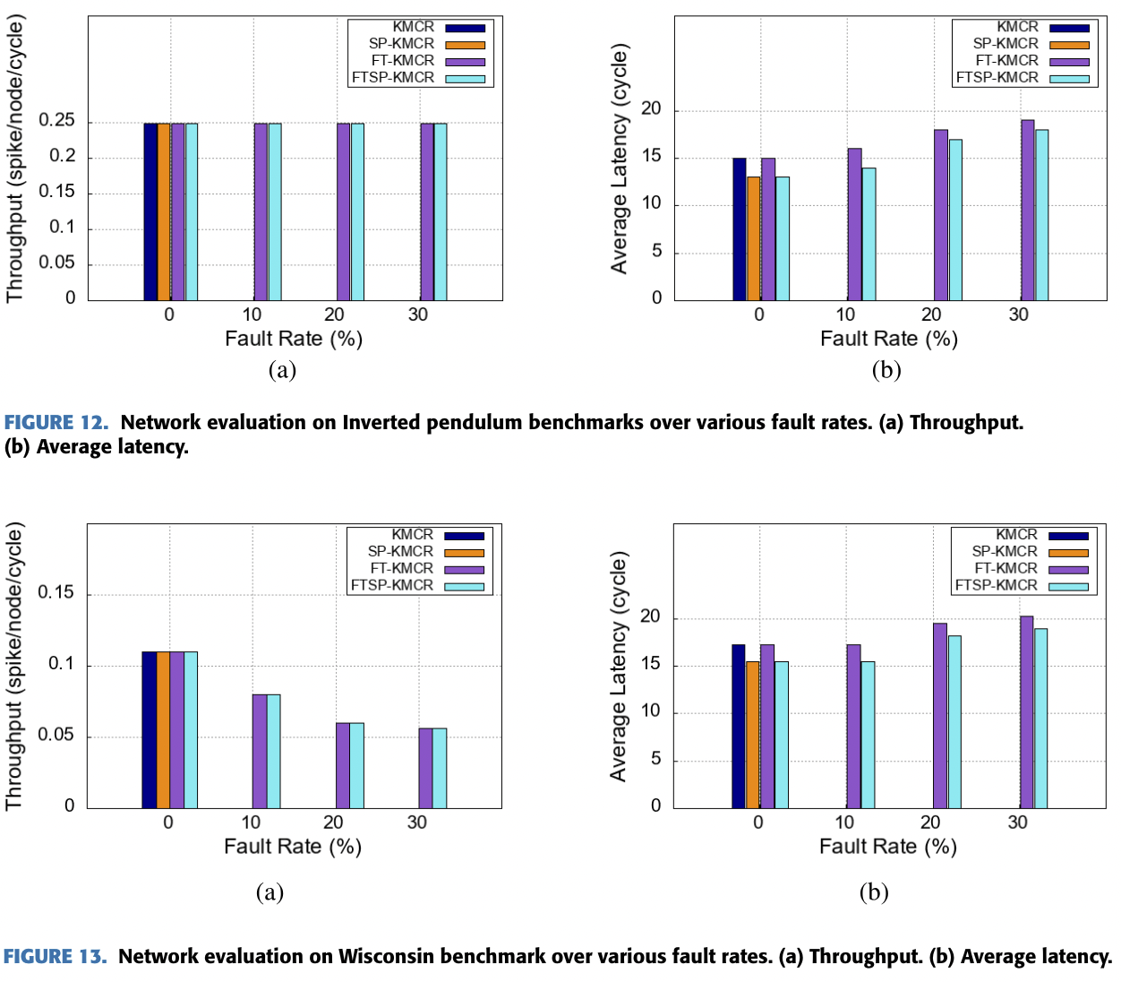
Evaluation (with faults)
Notes:
• The second was carried out with faults using the FTSP-KMCR and the FT-KMCR algorithms.

Slide 16
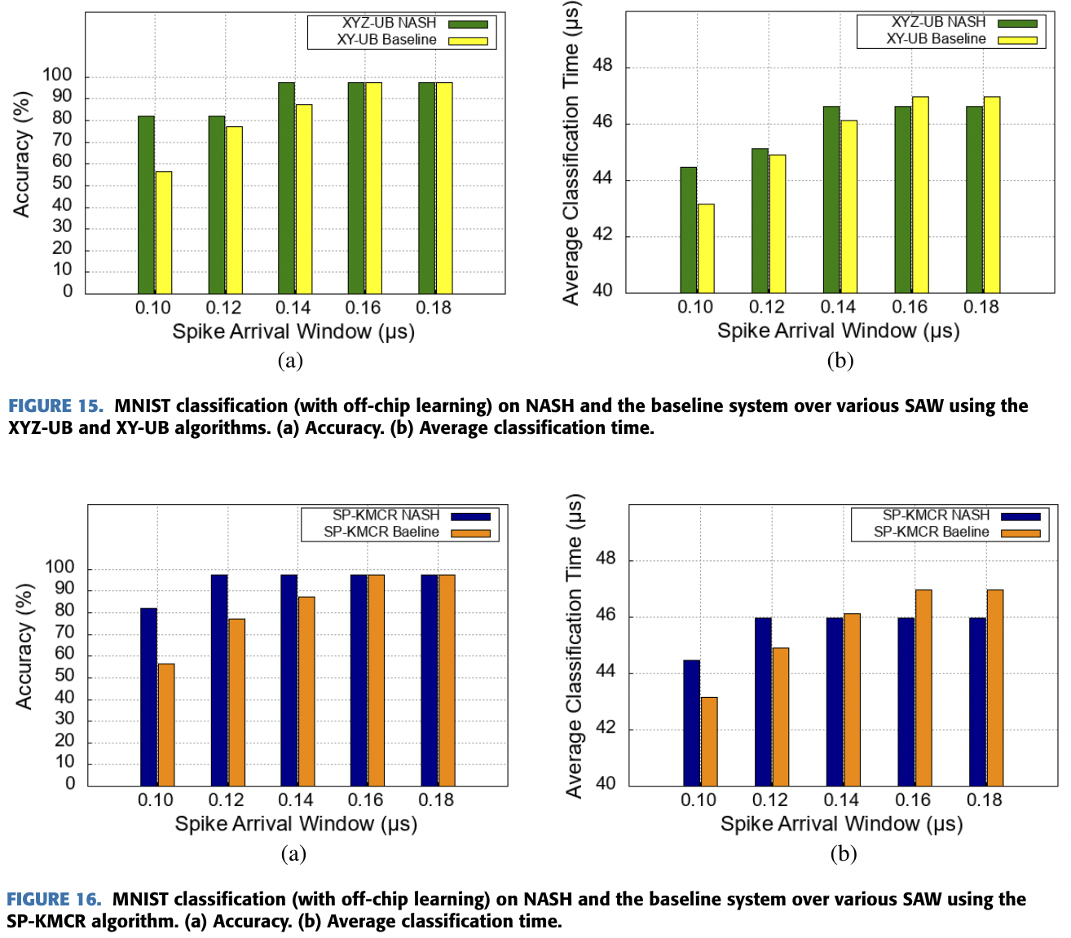
Evaluation (without faults)
Benchmark:
- MNIST dataset
Notes:
The author also used the MNIST dataset to as an evaluation method, which is a multilevel dataset that consists of 10 classes in which we can classify numbers from 0 to 9.
• The result of the classification’s accuracy and avg classification time for XYZ-UB and SP-KMCR method on both the baseline and the NASH systems over various Spike Arrival Windows can be seen in these figures

Slide 17
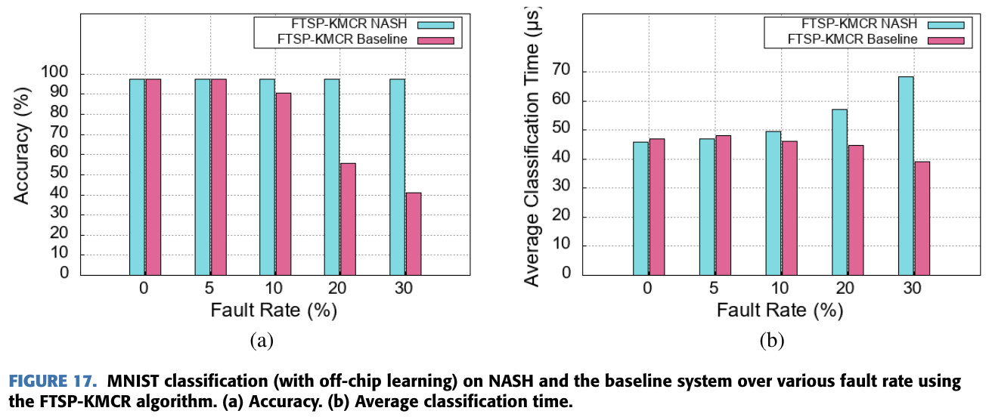
Evaluation (with faults)
Notes:
Finally the following figure shows the accuracy and avg classification time over different fault rates using FTSP-KMCR on both baseline and NASH systems using the MNIST dataset.

Slide 18
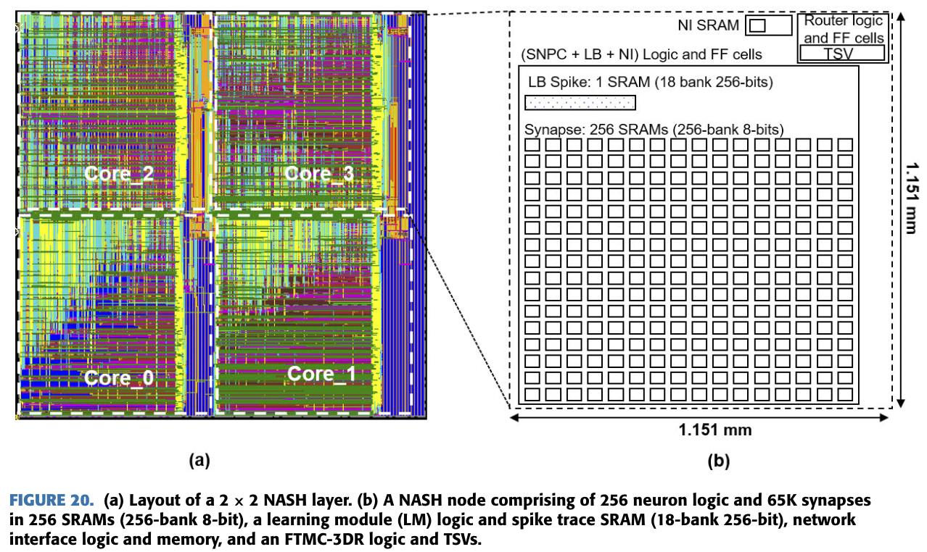
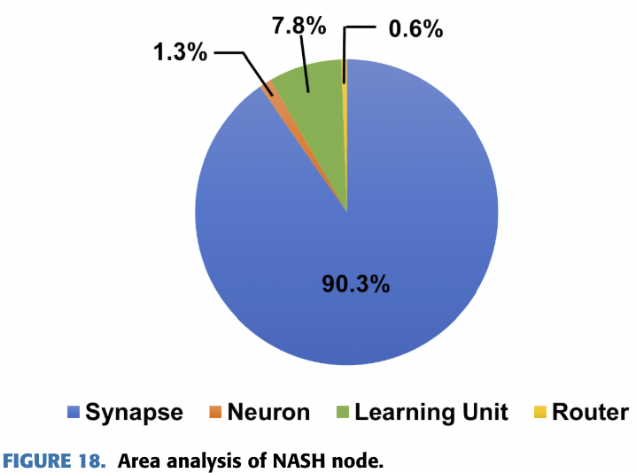
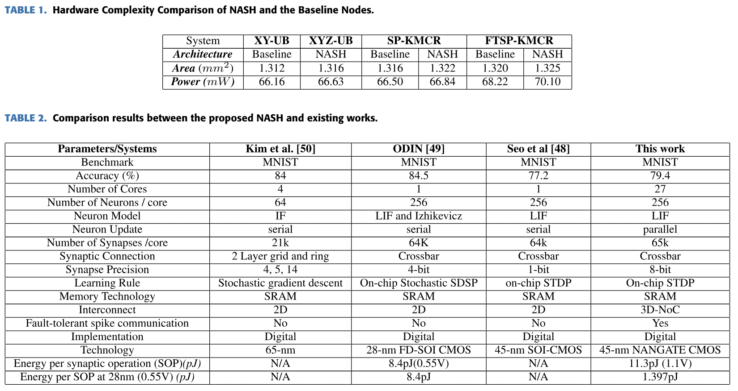
Hardware Complexity Analysis

Slide 19
Comparison with Existing Works

Slide 20
Overview
Introduction
Prior Works
NASH System Architecture
Evaluation Results
Conclusion

Slide 21
Conclusion
Summary of the NASH system design and architecture
Scalability, parallelism, and throughput advantages of 3D-NoC
Benefits of SNPC's 256 physical neurons for parallel updates
FTSP-KMCR routing algorithm for spike communication challenges
Performance evaluation with fault tolerance: accuracy and ACT metrics
Notes:
In conclusion, the NASH system leverages 3D-NoC for high scalability and throughput, with 256 physical neurons enabling efficient updates.
- The fault-tolerant shortest-path K-means-based multicast routing algorithm (FTSP-KMCR) algorithm addresses spike communication challenges.
- And NASH demonstrated high fault tolerance with better accuracy and shorter average classification time (ACT).

Slide 22
References
O. M. Ikechukwu, K. N. Dang and A. B. Abdallah, "On the Design of a Fault-Tolerant Scalable Three Dimensional NoC-Based Digital Neuromorphic System With On-Chip Learning," in IEEE Access, vol. 9, pp. 64331-64345, 2021, doi: 10.1109/ACCESS.2021.3071089.

